Slide 1
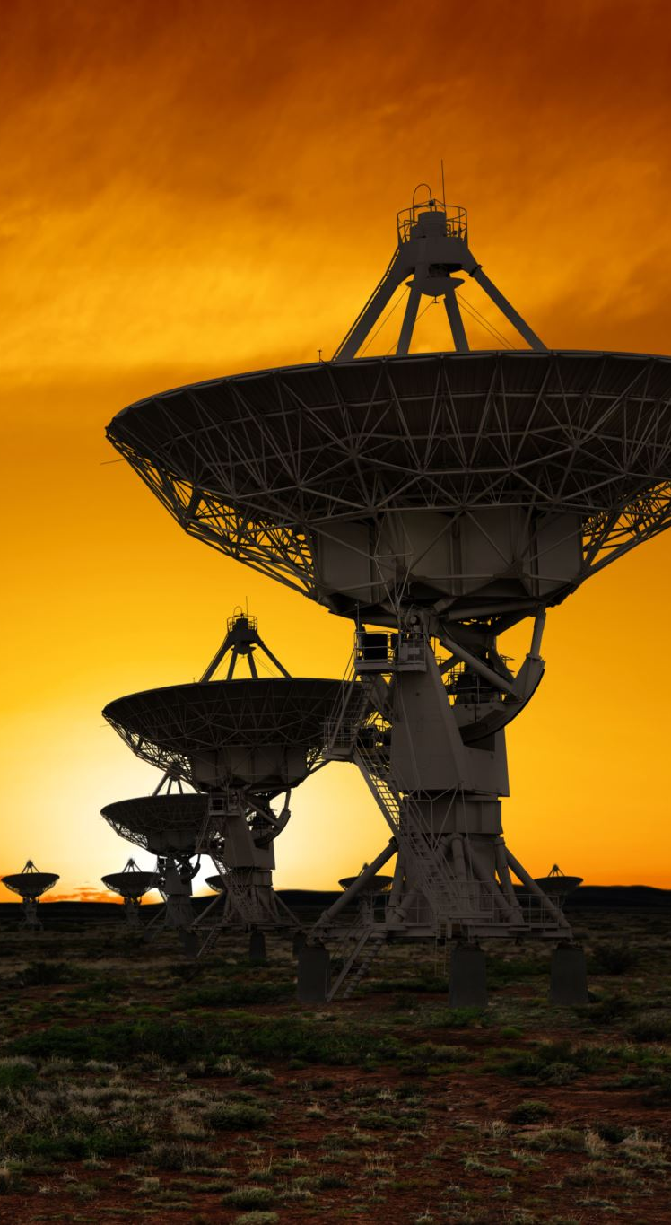

Satellite Communication By Prof. Dr. Sebastian Helmle

Slide 2
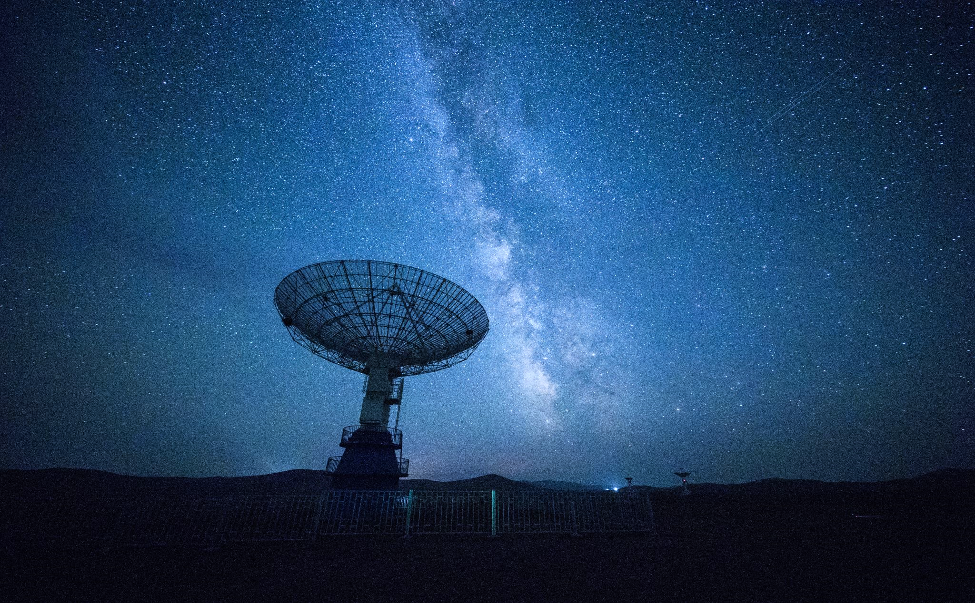
Multiple access (MA) techniques used for satellite communications
Presented by : Tanu Agarwal
Matriculation No. : 1428490
Email : tanu.agarwal@stud.fra-uas.de

Slide 3
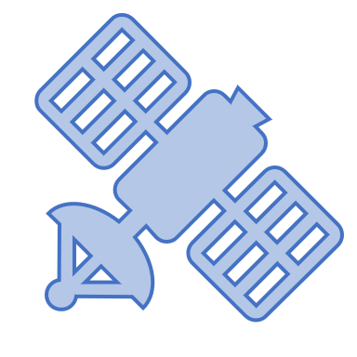
Introduction
Code Division Multiple Access (CDMA)
Space Division Multiple Access (SDMA)
Frequency Division Multiple Access (FDMA)
Time Division Multiple Access (TDMA)
Random Division Multiple Access (RDMA)

Slide 4
Access Techniques
Multiple Access Technique
Allow multiple users to share and exchange information simultaneously.
Optimal Bandwidth Allocation.
Multiple earth stations that can be geographically apart are accessing the Satellite.
Increase efficiency and utilize the resources of the satellite.
Single Access Technique
Satellite transponder’s channel is only loaded with a single transmission carrier.
Not frequently used due to its high operational costs.
Used on heavy-traffic routes and requires large earth station antennas.
Notes:
Transponder refers to a device onboard a satellite that receives signals from Earth, amplifies them, modifies the frequency if necessary, and retransmits them back to Earth.
Efficiency Increase: providing several services such as broadcasting, telecommunications.

Slide 5
Methods used in MA techniques based on circuit Allocation
Pre-Assigned MA
Allocated on a fixed or partially fixed basis to certain users, irrespective of traffic fluctuations.
Not open for general use and reserved for the allocated users.
Dealing with circuits experiencing continuous and substantial traffic.
Demand-Assigned MA
All circuits are accessible to every user and are allocated based on demand.
More efficient overall utilization of circuits.
More expensive and complex to implement.
Random Access System
Lacking control over the timing accessed or frequency slots accessed.
Example- CDMA.
Notes:
Circuits: individual communication channels through the multiple-access transponder.

Slide 6
Multiple access (MA) techniques
Frequency Division Multiple Access (FDMA): Assigns each relevant Earth Station, a distinct working carrier Radio Frequency (RF) within the Satellite’s transponder BW.
Time Division Multiple Access (TDMA): Earth Stations transmit in non-overlapping time slots in the form of bursts.
Code Division Multiple Access (CDMA): Distinguishing signals through code identification such as Pseudorandom Noise (PN) sequence.
Space Division Multiple Access (SDMA): All Earth stations use the same RF simultaneously within a distinct space allocated for each link through separate spot beams.
Random Division Multiple Access (RDMA): Users asynchronously share the same transponder by randomly transmitting short bursts or packet divisions.

Slide 7
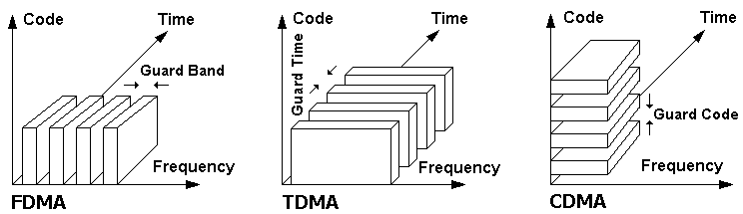
Concepts of multiple access: (a) FDMA; (b) TDMA; (c) CDMA
Fig. 1: The concepts of multiple access: (a) FDMA; (b) TDMA; (c) CDMA.

Slide 8
Frequency Division Multiple access (FDMA)
Most prevalent and initial multiple access scheme.
The repeater channel’s bandwidth is segmented into sub-bands.
Guard bands are required to prevent interference.
Expensive filters are required such as an intermediate frequency (IF) amplifier for filtering.
Two main interferences:
Adjacent Channel Interference- due to overlapping of spectral carrier power between adjacent channels.
Intermodulation- caused due to non-linear amplification.
FDMA can be multiplexed with TDM, SCPC, and PSK techniques.

Slide 9
Adjacent Channel Interference (ACI)
Channel bandwidth accommodates multiple carriers across different frequencies.
The Earth station’s receiver must filter these carriers effectively.
Carrier spectra are separated from each other by a wide frequency guard band.
Low Spectral Efficiency.
Higher operating cost, per carrier, of the space segment.
For effective spectral Bandwidth utilization, a technical and economic comprise is necessary.
Part of the power of a carrier adjacent to a given carrier will be captured by the receiver tuned to the frequency of the carrier considered.
Overlapping causes noise.
Fig. 2: Adjacent Channel Interference
Notes:
Leads to inefficient use of the channel bandwidth

Slide 10
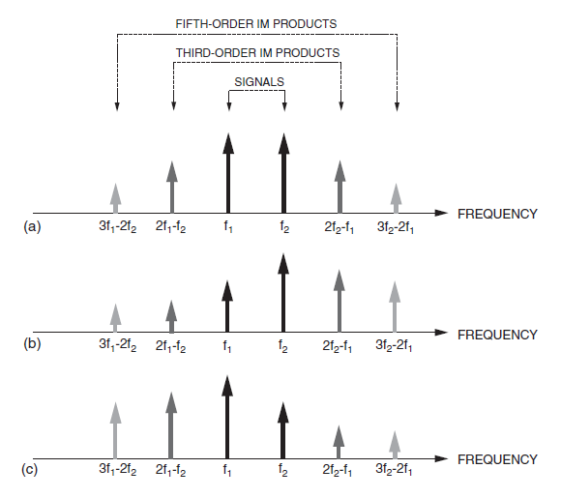
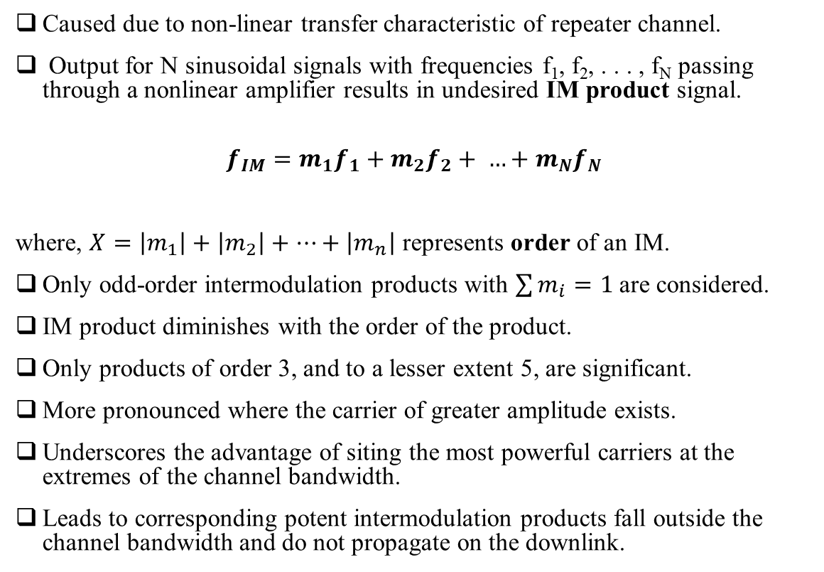
Intermodulation (IM)
Caused due to non-linear transfer characteristic of repeater channel.
Output for N sinusoidal signals with frequencies f₁, f₂, . . . , f_{N} passing through a nonlinear amplifier results in undesired IM product signal.
$$f_{IM}=m_{1}f_{1}+m_{2}f_{2}+ …+m_{N}f_{N}$$
where, $X=\left|m_{1}\right|+\left|m_{2}\right|+…+\left|m_{n}\right|$ represents order of an IM.
Only odd-order intermodulation products with $\sum{m_{i}}=1$ are considered.
IM product diminishes with the order of the product.
Only products of order 3, and to a lesser extent 5, are significant.
More pronounced where the carrier of greater amplitude exists.
Underscores the advantage of siting the most powerful carriers at the extremes of the channel bandwidth.
Leads to corresponding potent intermodulation products fall outside the channel bandwidth and do not propagate on the downlink.
Fig. 3: IM products in the case of two sinusoidal signals

Slide 11
Shortcoming of FDMA
Limited flexibility during reconfiguration.
Frequency replanning is not possible.
Hardware modifications required for replanning such as a transmitter, receiver, and filter changes are required.
Loss of capacity as the number of accesses increased because of the generation of IM products.
Low efficiency in the case of a large number of carriers.
Back-off problem: Need to operate at a reduced satellite transmitting power.
Capture Effect: During FM reception, the stronger of two signals as, or near, the same frequency or channel will be demodulated.
However, FDMA is simple to implement, and no timing synchronization is needed.

Slide 12
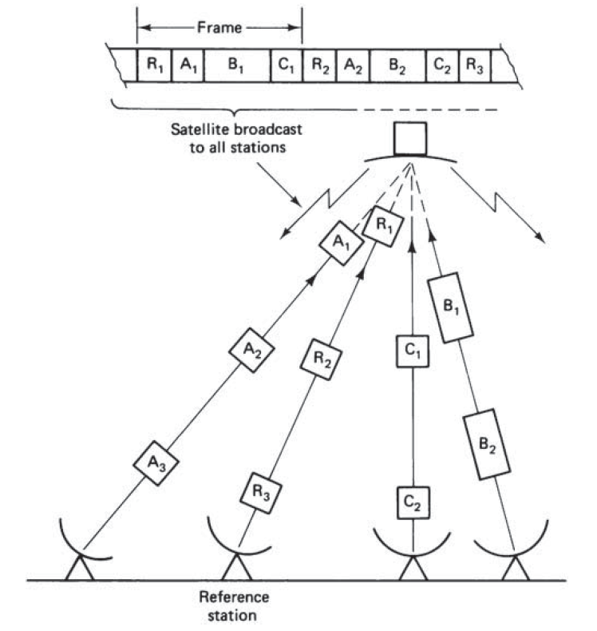
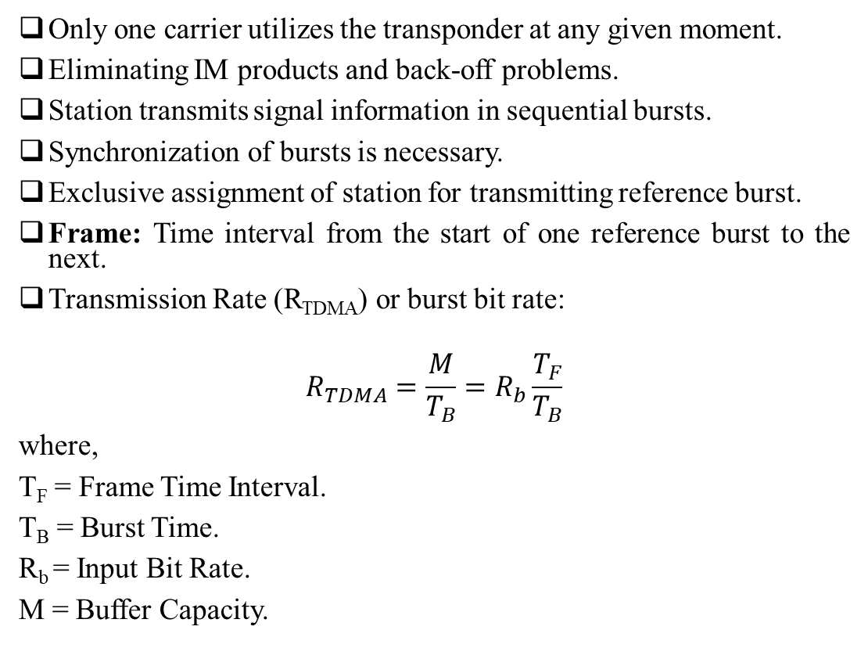
Time Division Multiple access (TDMA)
Only one carrier utilizes the transponder at any given moment.
Eliminating IM products and back-off problems.
Station transmits signal information in sequential bursts.
Synchronization of bursts is necessary.
Exclusive assignment of station for transmitting reference burst.
Frame: Time interval from the start of one reference burst to the next.
Transmission Rate (R_{TDMA}) or burst bit rate:
$$R_{TDMA}=\frac{M}{T_{B}}=R_{b}\frac{T_{F}}{T_{B}}$$
where,
T_{F} = Frame Time Interval.
T_{B} = Burst Time.
R_{b} = Input Bit Rate.
M = Buffer Capacity.
Fig. 4: Burst Synchronization in TDMA

Slide 13
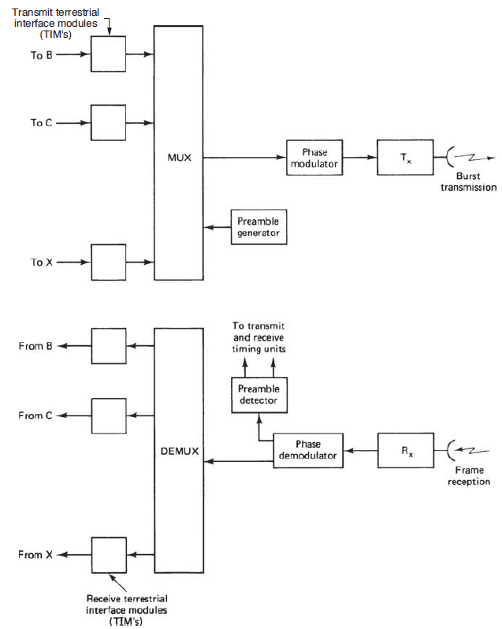
Basic equipment units in a TDMA ground station
Digital traffic from terrestrial links entering Earth Station A is directed to destination stations labelled B, C, and X.
TIMs convert incoming continuous-bit-rate signals into intermittent-burst-rate mode.
Undergo time-division multiplexing in the time-division multiplexer(MUX).
Preamble- time slots at the start of each burst for transmitting timing and synchronizing information.
Entire burst is employed to phase modulate the radio frequency (RF) carrier and then transmit.
At reception, the RF carrier undergoes conversion to an intermediate frequency (IF) before demodulation
Dedicated preamble detector supplies timing details for both the transmitter and receiver
Figure 5: Basic Equipment units in a TDMA ground station.

Slide 14
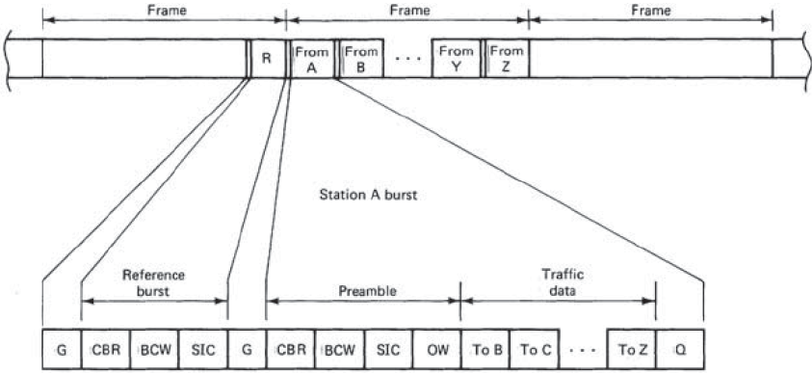
Frame and Burst Format
Types of Burst
Reference Burst: At the start of each frame to supply timing details for acquiring and synchronizing bursts.
Traffic Burst: consists of time slots for the Preamble, actual traffic data, and the Postamble.
Guard time (G):To avoid overlap between bursts.
Carrier and bit-timing recovery (CBR): for the recovery of a coherent carrier signal from the burst.
BCW (Burst Code Word): for burst-timing purposes and identify whether it is a reference burst or traffic burst.
SIC (Station Identification code): used to identify the transmitting station.
Orderwire (OW) channel: provide communication such as voice and telegraphy.
Postamble (Q): Pause or recovery time.
Figure 6: Frame and burst format in a TDMA system

Slide 15
Pros and Cons of TDMA systems
Advantages | Disadvantages
Replanning for traffic changes is possible. | Need for Synchronization
Hardware modification not needed. | Setup involves complex procedures as compared to FDMA.
Software-driven architecture. | Costly Hardware as compared to FDMA hardware.
No Intermodulation (IM) products | Two reference stations required.
High efficiency even with a considerable number of accesses. | Larger peak power and BW requirements.
No need to control the transmitting power of the stations.
Simplifies tuning processes

Slide 16
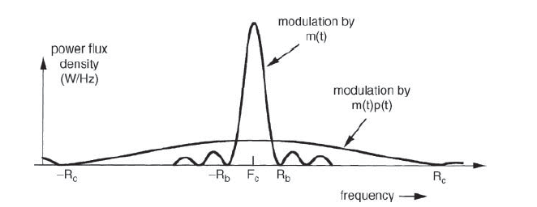
Code Division Multiple access (CDMA)
Spread Spectrum Multiple Access (SSMA).
Information carried across a significantly broader bandwidth than the original signal.
Each carrier is distinguished by a unique code waveform.
Multiplying the modulated signal by a PN code generator.
Chip rate (R_{c}) is considerably higher than the information bit rate (R_{b}).
Types:
Direct Sequence CDMA
Frequency Hopping CDMA
Figure 7: Frequency Spectrum in DS-CDMA
Notes:
Each user is allocated a signature sequence, distinguished by a unique code selected from a set of codes specifically assigned to users in the system. This code is combined, serving as an additional modulation, with the useful information signal. On the receiving end, a particular mobile user can identify and isolate the signal intended for it by using its unique code, thereby extracting the relevant information by performing the correlation technique.

Slide 17
Pros and Cons of CDMA systems
Advantages | Disadvantages
No Need for Synchronization. | Low efficiency.
Simplicity of Operation. | BW requirement is much higher for spread carrier segment.
Interference Resistance. | Lower throughput compared to other systems.
Protection against multiple paths. | Has finite number of codes.
Can offer frequency reuse in the case of multibeam Satellites.

Slide 18
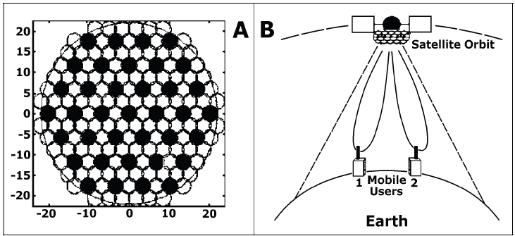
Space Division Multiple access (SDMA)
Segmenting the radio coverage into focused radio beams that reuse the same frequency.
Enhances the Signal-to-Interference Ratio.
Attain Spatial separation through dedicated beam formation differentiated by polarization.
Two beam-forming strategies through:
Switched Spot beam Antenna.
Adaptive Array Antenna.
Switched Spot beam Antenna creates overlapping beams for comprehensive coverage.
Adaptive Array Antenna chooses a specific beam pattern from a set of preset fixed patterns based on the location of the user.
Figure 8: Beam patterns from (a) Switched Spot Beam Antenna. (b) Adaptive Antenna for SDMA.
Notes:
The direction of the line traced out by the tip of the electric field vector determines the polarization of the wave.
specifies the geometrical orientation of the oscillations

Slide 19
Advantage of SDMA
Reduction in interference from other systems.
Mitigation of the negative effects of multipath signals.
Increased signal-to-interference ratio (SIR).
Possibility of tighter channel reuse patterns.
Creation of separate spatial channels within each cell
Intra-cell reuse
Lower total power radiation leading to reduced network-wide RF pollution
smaller power amplifier sizes
Knowledge of the direction of each spatial channel.
Accurate determination of the signal source’s position.
Compatibility with GSM, PHP, DECT, IS-54, IS-95, and other formats.

Slide 20
Random Division Multiple access (RDMA)
Random transmission of limited-duration packets without any restrictions, forming bursts.
Involves both time division and random access, allowing message transmission with potential collisions.
Lead to interference noise, necessitating burst retransmission multiple times with random delays.
Measures: Throughput (traffic volume to channel capacity ratio) and Mean Transmission Delay (average time from message generation to correct reception).
ALOHA protocol (Asynchronous protocol)
Multiple users randomly access time-shared a single RF to transmit packets.
decentralized, cost-effective transmission.
maximum normalized throughput limit of 18%.
Slotted ALOHA protocol (Synchronous protocol)
divides time into slots matching a single packet burst.
Synchronized by network clocks.
Eliminates partial collisions.
Max normalized throughput of 50-60%.
Slot Reservation Aloha: Extension to the slotted Aloha, Earth station reserves time slots for transmission.

Slide 21
Conclusion
Economic factors to be considered for selection of MA.
For significant traffic per carrier and limited users, FDMA is preferred.
For small traffic per carrier and a high number of users: TDMA/CDMA is preferred.
CDMA is preferred for small stations having inter-system interference.
SDMA is efficient in reusing spectrum across distinct spatial domains, especially critical in BW-limited contexts like cellular networks.
RDMA can be used for applications characterized by short messages with random generation and extended silent intervals between messages.

Slide 22
References
[1] S. D. Ilcev, “Implementation of Multiple Access Techniques Applicable for Maritime Satellite Communications”, TransNav, the International Journal on Marine Navigation and Safety of Sea Transportation, vol. 7, no. 4, pp. 529–540, 2013, doi: 10.12716/1001.07.04.08.
[2] S. D. Ilcev,“Global Mobile Satellite Communications for Maritime, Land and Aeronautical Applications,”
Boston: Springer, 2005.
[3] D. Roddy, “Satellite Communications”, Fourth Edition McGraw-Hill, 2006, pp. 423–489.
[4] G. Maral, M. Bousquet, and Z. Sun, “Satellite communications systems: systems, techniques and technology”,
Sixth Edition John Wiley & Sons, 2020, pp. 275-323.
[5] S. D. Ilcev, “Space Division Multiple Access (SDMA) applicable for Mobile Satellite Communications”, in 2011 10th International Conference on Telecommunication in Modern Satellite Cable and Broadcasting Services (TELSIKS), IEEE, Oct. 2011, pp. 693–696. doi: 10.1109/TELSKS.2011.6143206.

Slide 23
Vielen Dank und Auf Wiedersehen!

